Slide 1
CAPSTONE PROJECT
DATA SCIENCE

Slide 2
Objective of the project
The aim of this project is to extract mobile phone data from Flipkart and prepare it for meaningful analysis.
The data undergoes cleaning and preprocessing to ensure reliability and consistency
Statistical analysis and hypothesis testing are performed to uncover key insights.
Supervised and unsupervised machine learning techniques are applied to predict outcomes and identify patterns.
Finally, hyperparameter tuning is carried out to enhance model accuracy and performance.

Slide 3
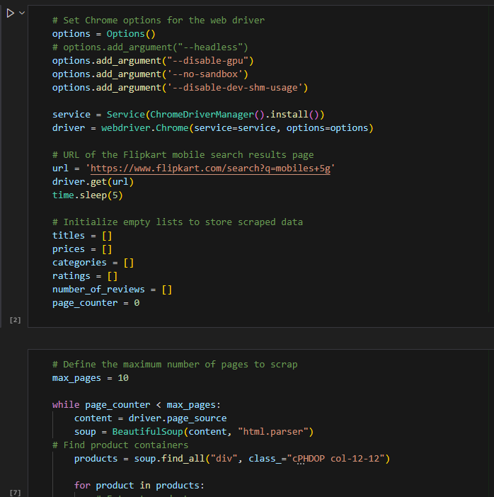
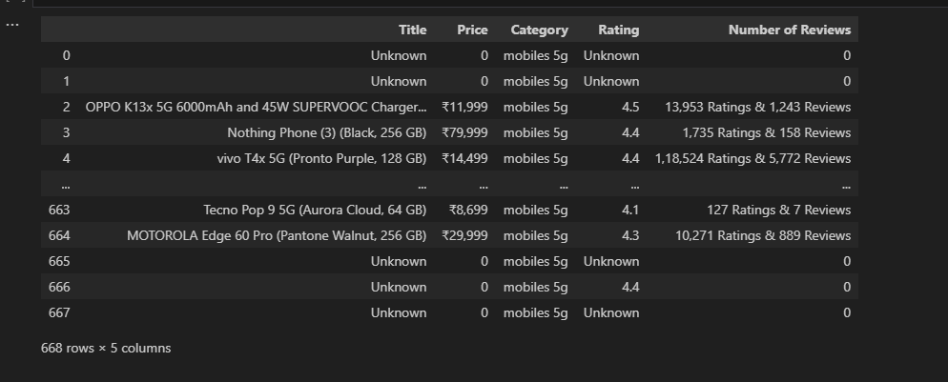
Web Scraping
Performed web scraping by using python libraries such as beautiful soup scraped the mobile data from Flipkart.
Scraped 10 pages . Having 5 columns and 668 rows and I have saved it as CSV file.

Slide 4
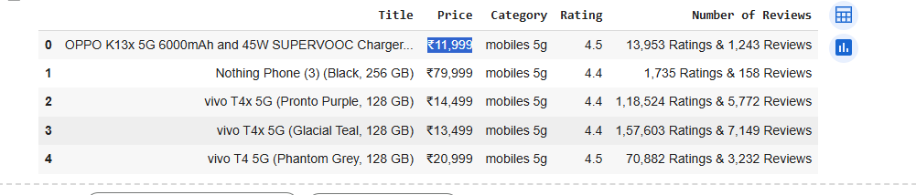
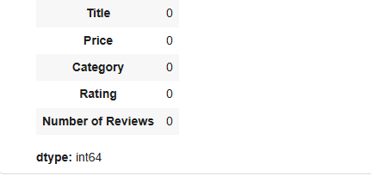
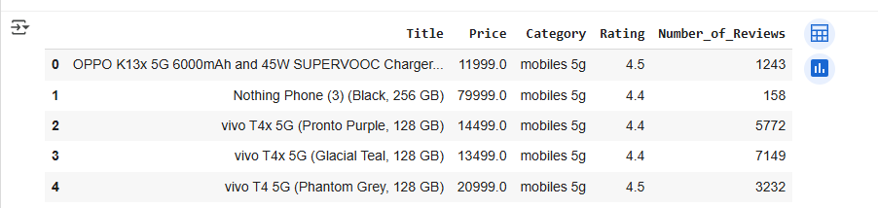
DATA CLEANING
Performed data cleaning process before Analysis.
Removed unknown and 0 values.
Removed currency symbol and standardize the formats.
Removed duplicates.

Slide 5
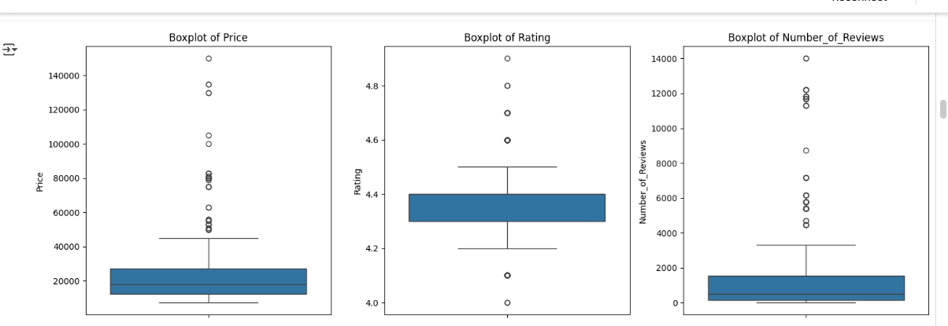
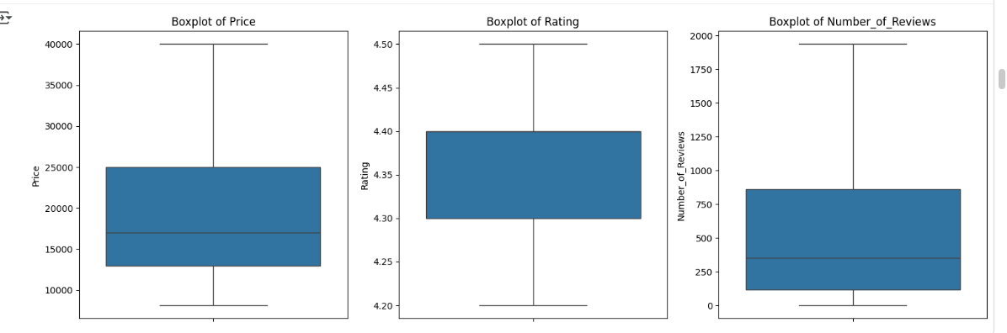
Removed Outliers

Slide 6
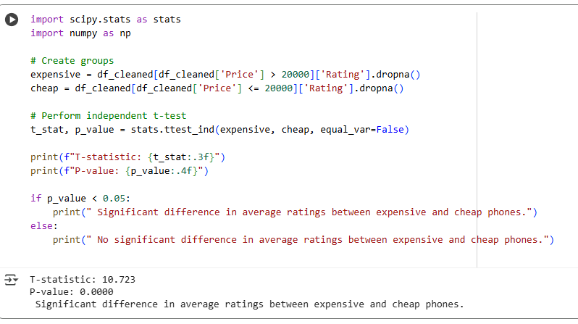
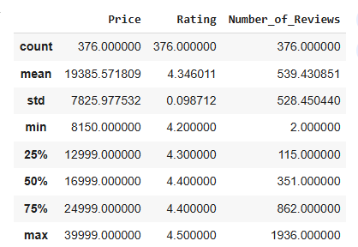
Statistical Analysis
Performed t-test compared the two independent samples.
Got p-value< 0.05(reject null hypothesis)
Significant difference in average ratings between expensive and cheap mobiles.

Slide 7
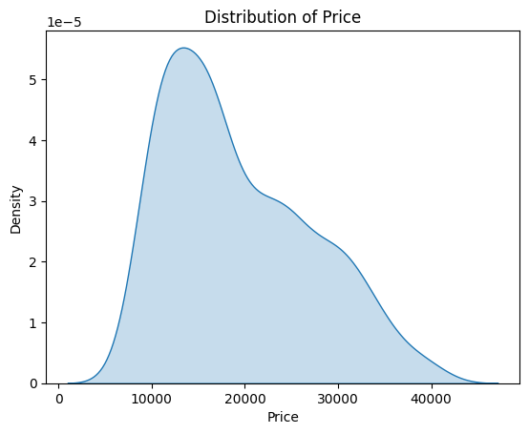
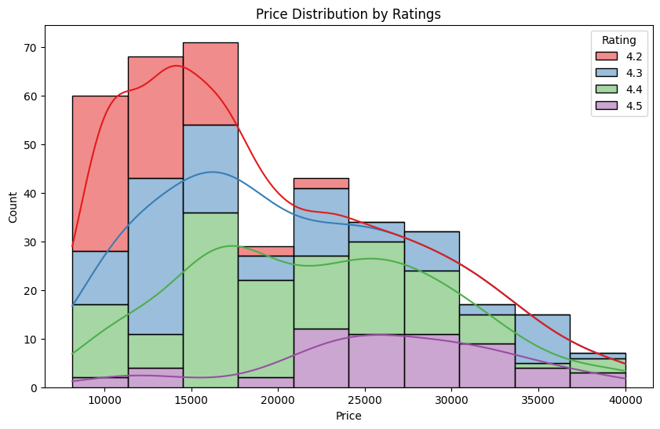
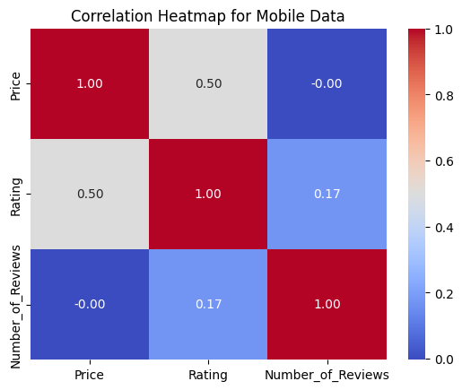
EDA

Slide 8
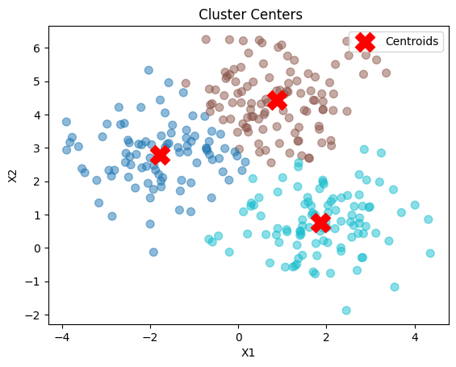
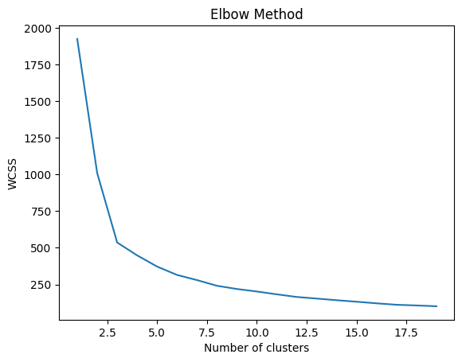
Unsupervised Learning
Performed K-means clustering to group the mobiles based on the price, Rating, number of reviews.
Performed elbow method to determine the optimal number of clusters.
And created new column to label the each product to its group.

Slide 9
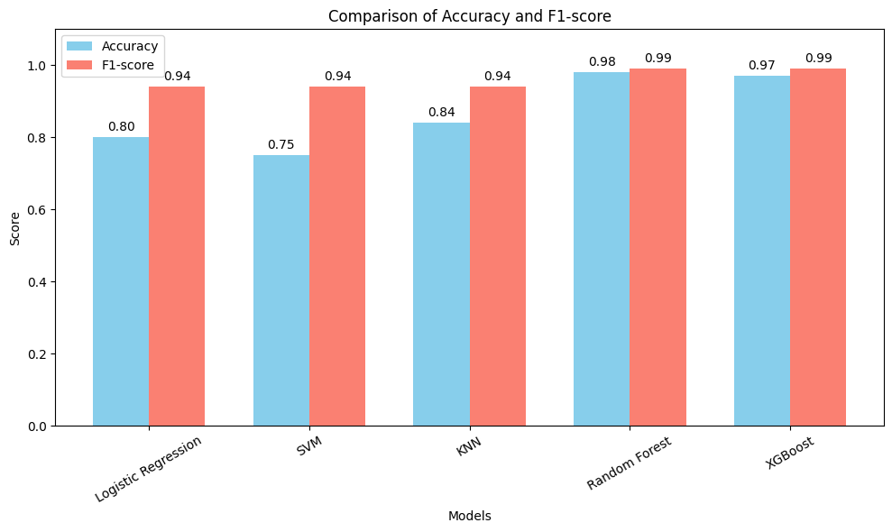
supervised Learning
In the supervised learning , implemented various classification algorithms to predict mobile phone categories based on features.
The algorithms, Logistic Regression, Support Vector Machine (SVM), K-Nearest Neighbors (KNN), Random Forest, and XGBoost.
Compared the accuracy, precision, recall, F1-score to identify the best model.

Slide 10
Hyperparameter Tuning
In Logistic regression:
C = 10 → The model allows less regularization, giving more flexibility to fit the data.
penalty = 'l2' → Uses Ridge regularization to prevent overfitting.
solver = 'lbfgs' → Optimization algorithm suitable for small-to-medium datasets.
cross-validation score = 0.99 → The model was highly accurate on unseen data.
In KNN:
neighbors = 9 → The model considers the 9 closest neighbors for classification.
weights = 'distance' → Closer neighbors have more influence on the prediction.
algorithm = 'auto' → Automatically selects the best algorithm for computing nearest neighbors.
metric = 'euclidean' → Euclidean distance to measure closeness between points.
Best cross-validation score = 0.9 → KNN performing well

Slide 11

Key insights
Expensive mobiles (> ₹20,000) tend to have significantly higher ratings than cheaper ones.
K-Means clustering identified three distinct groups of mobiles based on price, ratings, and number of reviews.
Random Forest algorithm got both accuracy and Fl-score highly.
Hyperparameter tuning improved model performance, and features like price, ratings, and reviews were key predictors.

Slide 12

Conclusion
Scraped the data from Flipkart using beautiful soup. Performed data cleaning process , statistical Analysis, unsupervised learning , supervised learning and performed hyperparameter tuning identify the trends of real-world dataset. There is a strong relationship between price and ratings, with clustering revealing clear market segments. Random forest best for predicting mobile dataset.

